Slide 1
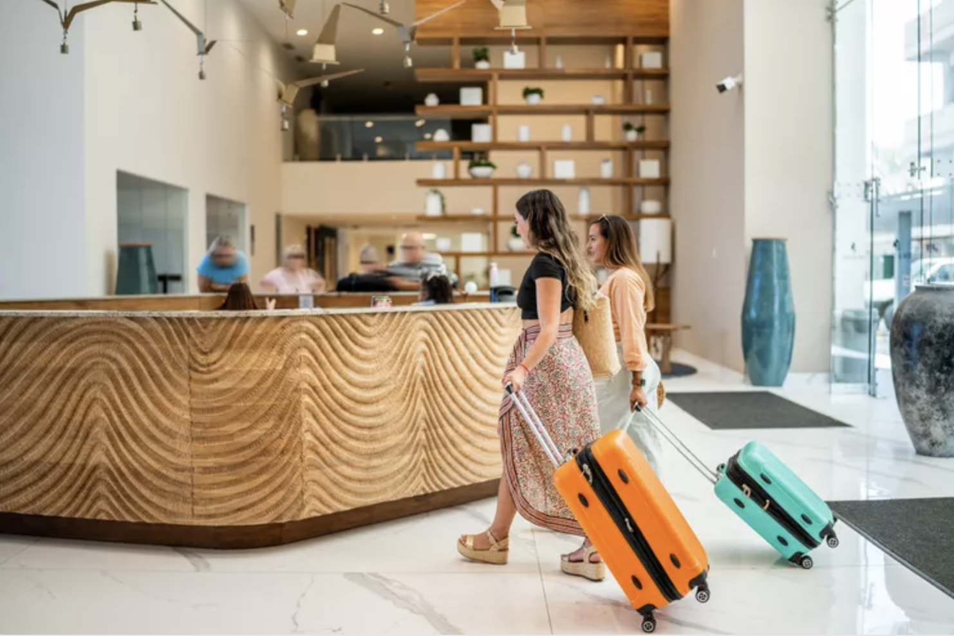
Project StayWise
Noach Meged
Project by Noach Meged

Slide 2

Project Overview
To predict the revenue of a hotel
with a ML model:
🔦
Help Hotel businesses to optimize Hotel Occupancy.
💰
Help Hotel businesses to create more profit.
🛎️
Help Hotel businesses to improve their services.

Slide 3
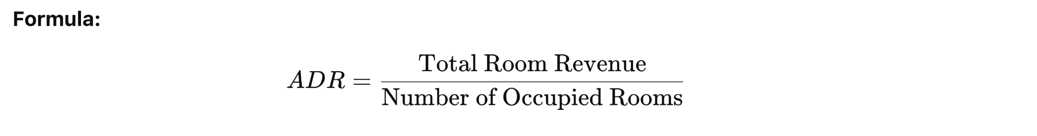
Data Selection and Preparation
Hotel bookings dataset:
Key Data Categories:
Booking Details – Hotel type, room type, parking, stay duration. country, meal plan
Guest Info – Number of guests, guest type, booking source, repeat guests.
Financial Data – Deposit type, agent/company, ADR (Average Daily Rate) in $

Slide 4
Feature Engineering and Selection (1 slide):
Discuss the process of feature engineering and how you selected features for your model.
Highlight any innovative techniques used or challenges encountered.
Feature Engineering and Selection
🧹 Cleaning data
Removed personal information for privacy.
Handled missing values by dropping NaNs.
🔧 Feature Engineering
Hotel Type: Encoded (City = 0, Resort = 1).
Country: 5 bins based on their mean ADR.
Lead Time: Binned into short, medium, long and very long-term.
Meal Plans: Mapped to numerical values (SC, BB, HB, FB).
Arrival Month: Converted from text to numeric (Jan =1, Feb =2, etc).
Country: Binned based on ADR quantiles.
👩🏻‍🏫 Business & Booking Features
Market Segment & Distribution Channel: Made bins based on their mean ADR.
Deposit Type: Encoded as No Deposit (0), Non-refund (1), Refundable (2).
No Stay Flag: Created flag if no nights were booked.
Customer type: One-hot encoded (Transient, Group, Contract, etc).
🏗️ Final Adjustments
Ensured consistency with model’s required feature set.
Predicted ADR (Average Daily Rate) using a trained Random Forest model.

Slide 5
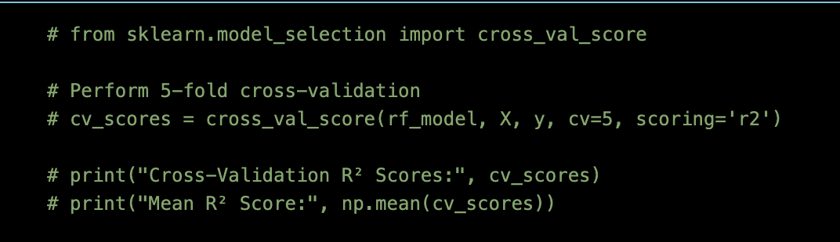
Model Building and Evaluation (1-2 slides):
Outline the types of models you experimented with and your rationale for selecting them.
Discuss the evaluation metrics and validation techniques used to assess model performance.
Model Building and Evaluation
Types of Models Experimented with:
Types of Models Experiment With, Linear Regression, Random Forest Model, Gradient Boosting
Reason – Highest R2 scores across evaluation metrics.
Low mean score error and low median score error.
Cross-validation results were consistent.

Slide 6
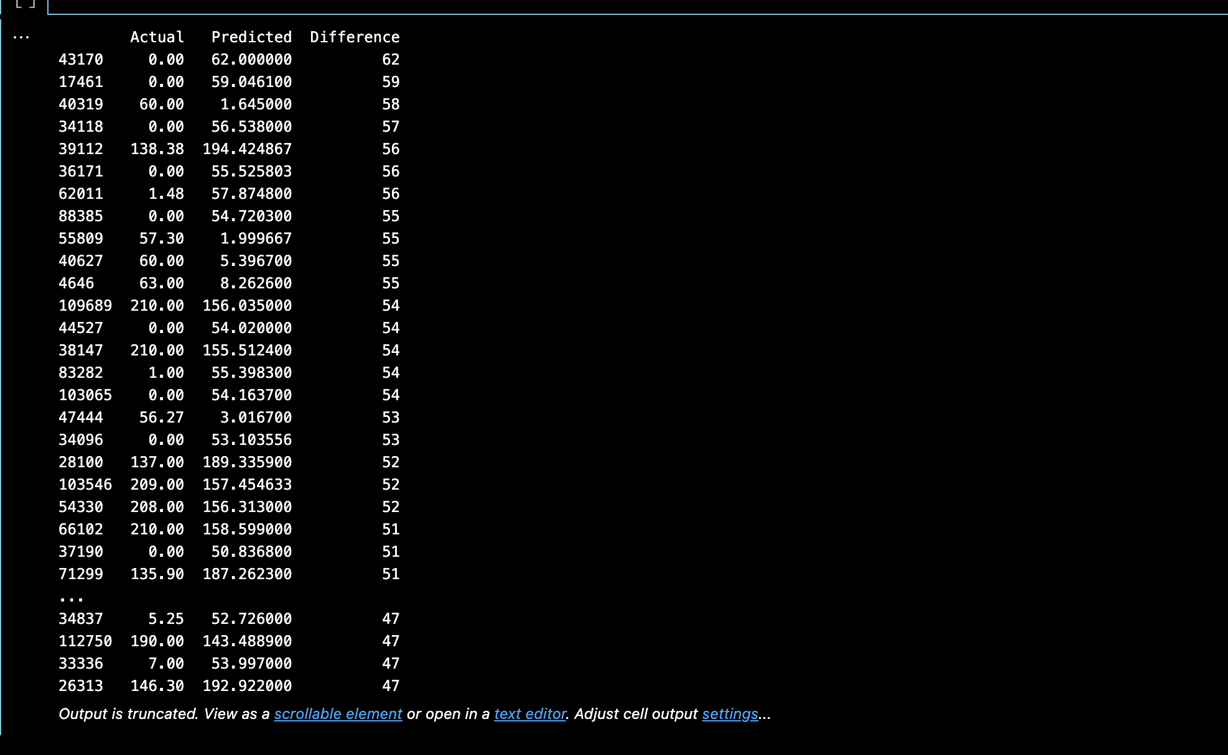
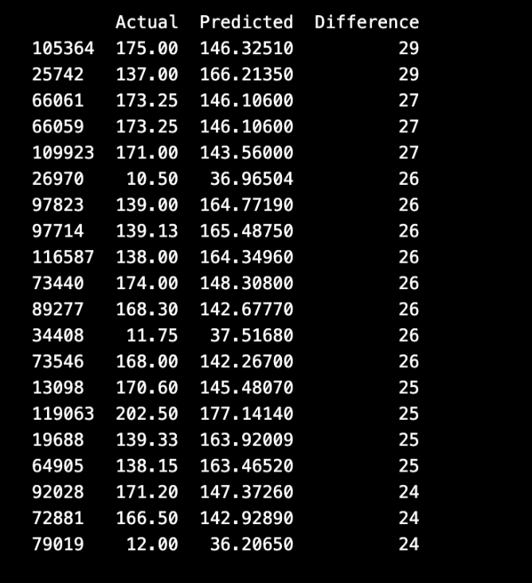
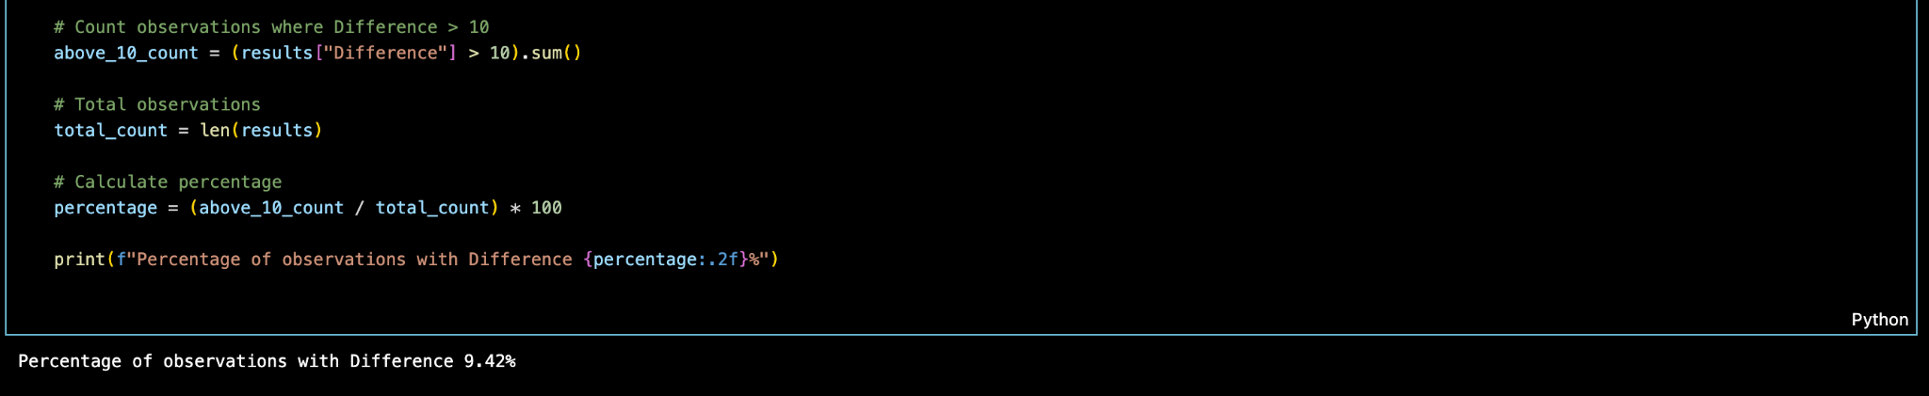
Hyperparameter Tuning and Model Optimization (1 slide):
Explain the hyperparameter tuning techniques employed (e.g., grid search, cross-validation).
Share insights on how these techniques improved your model’s performance.
HP Tuning and Model Optimization
Bla bla bla

Slide 7
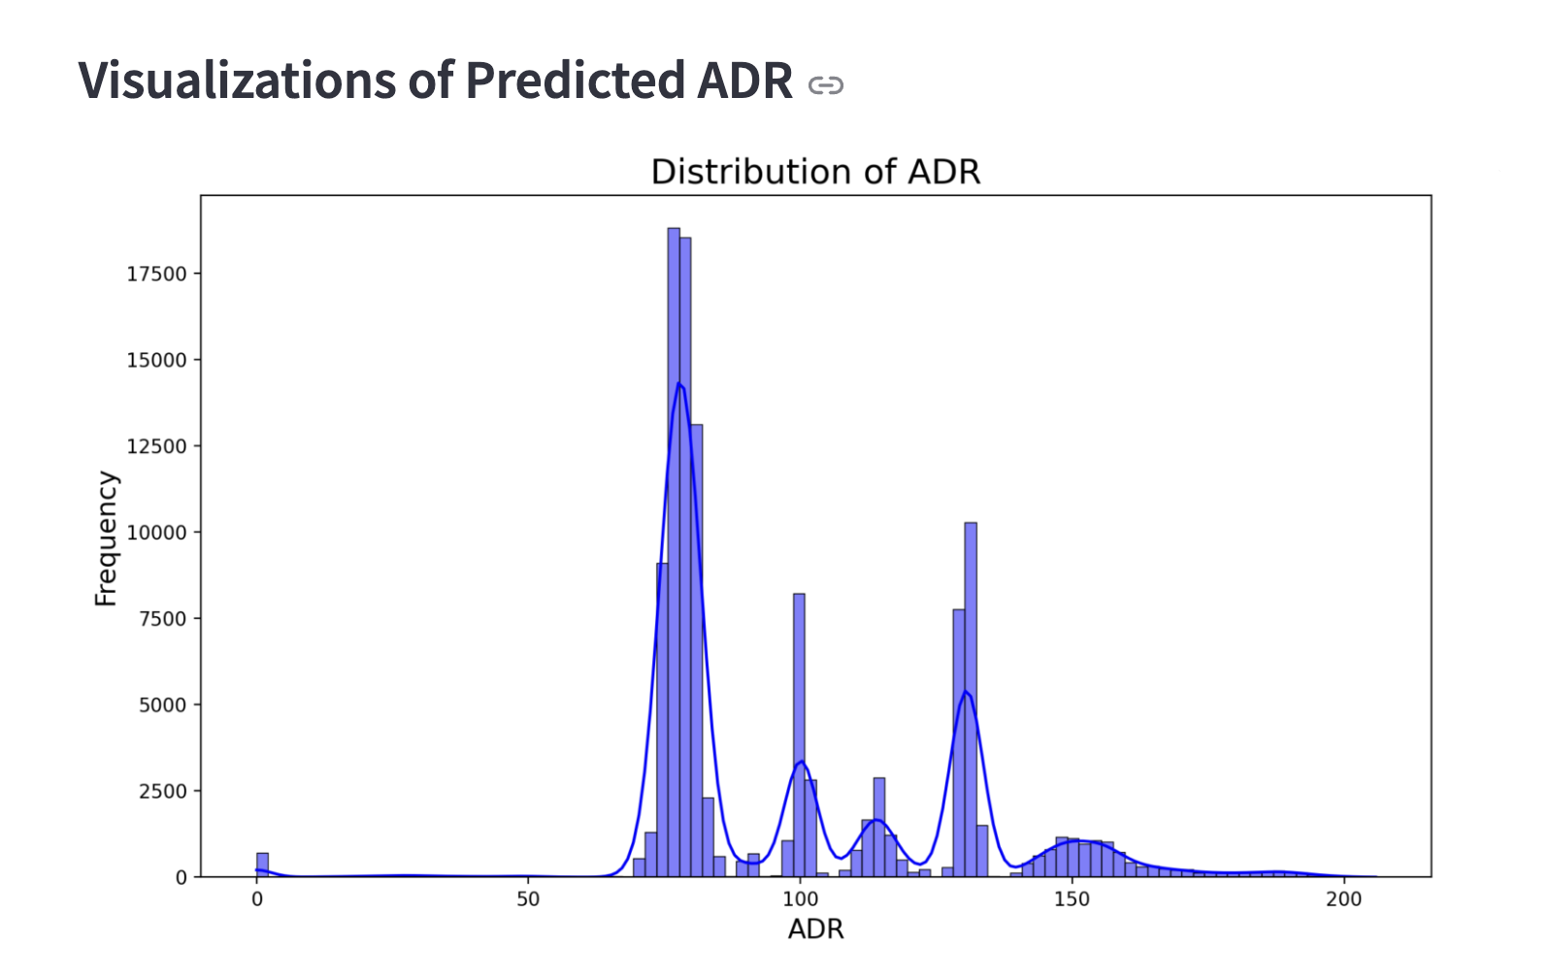
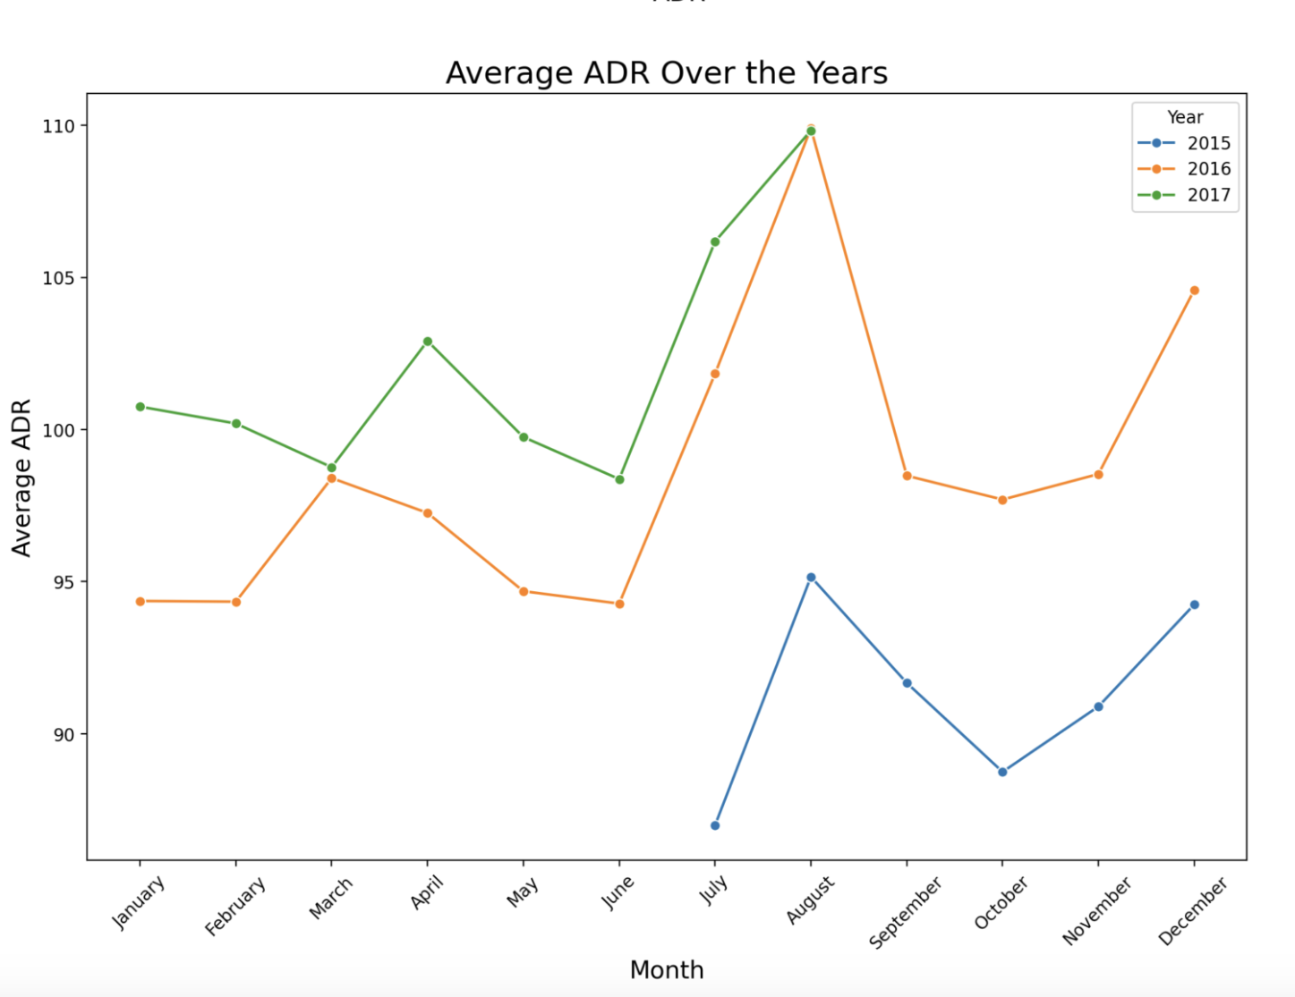
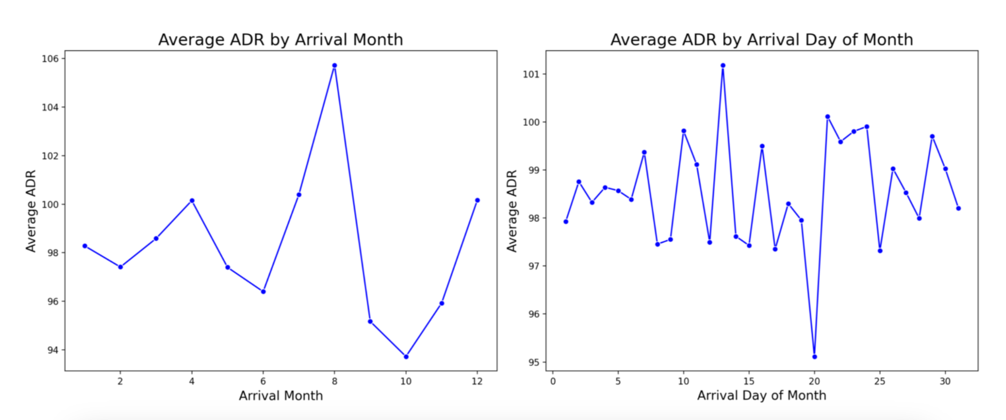
Key Findings & Insights
💡
The model is the best in predicting the majority of ADRs
💡
Country, seasonality and day of the month were the biggest predictor of ADR

Slide 8
Challenges and Learnings (1 slide):
Share significant challenges faced during the project and how you overcame them.
Highlight key learnings and takeaways from the project.
Challenges & Learnings
Challenges:
Learnings:
💭
It was hard to predict OUTLIERs
🏗️
Maybe use specific models to predict specific cases
💻
It was hard to make the app run as I wanted
🏗️
I learned to build an app using streamlit
📈
It was hard to build graphs to gain insight of ADR
🏗️
I shall take more time into building graphs

Slide 9
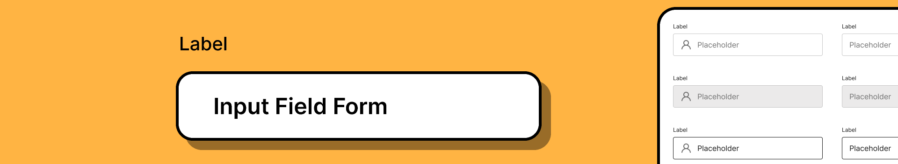
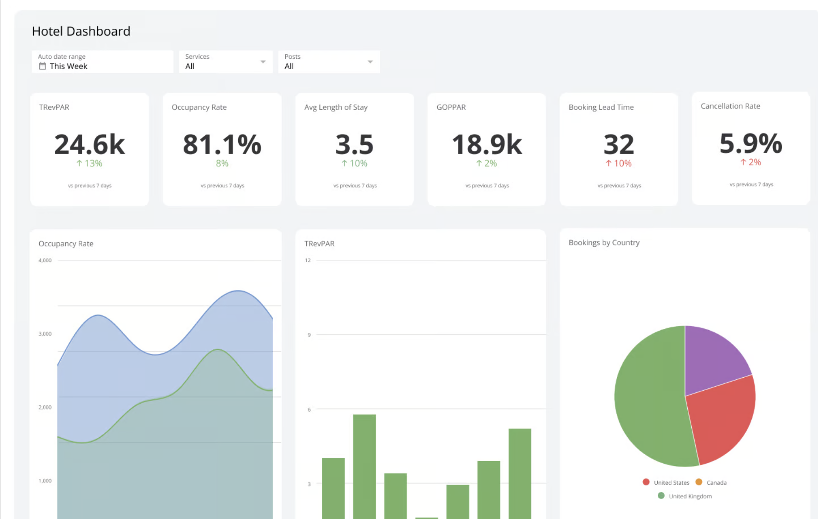
Future Work and Improvements (1 slide):
Suggest areas for future research or how the project could be expanded or improved with more time or resources.
Future Work & Improvements
🏗️
Put an input field for a hotel to put data in the database.
🏗️
Built a proper dashboard for Hotel to use instead of Python libraries.
🏗️
More data with multiple models to predict even better.

Slide 10
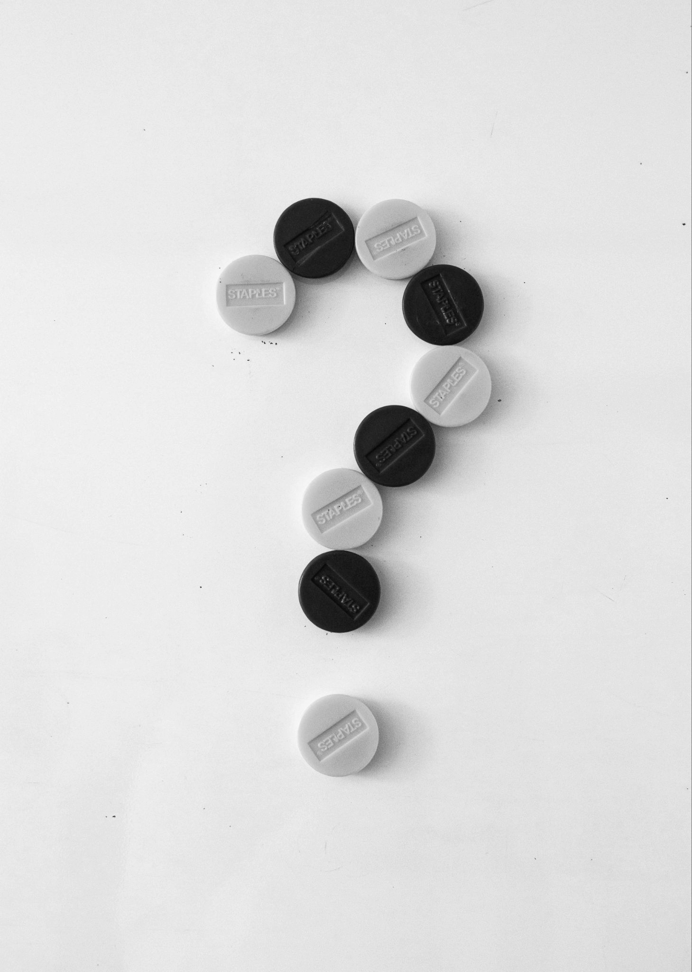
Thank you for Listening
Feel free to ask any questions.
8th March 2025
Project by Noach Meged

